Slide 1
Isostasy
Contributors: Harriet C.P. Lau
Keywords: colonialism, imperialism, plate tectonics, British Empire
Location: global
People: Krishna Singh Rawat, Nain Singh Rawat, George Everest
Last updated: December 6, 2020
Visit https://geo-context.github.io for the teacher’s companion guide to these slides.

Slide 2
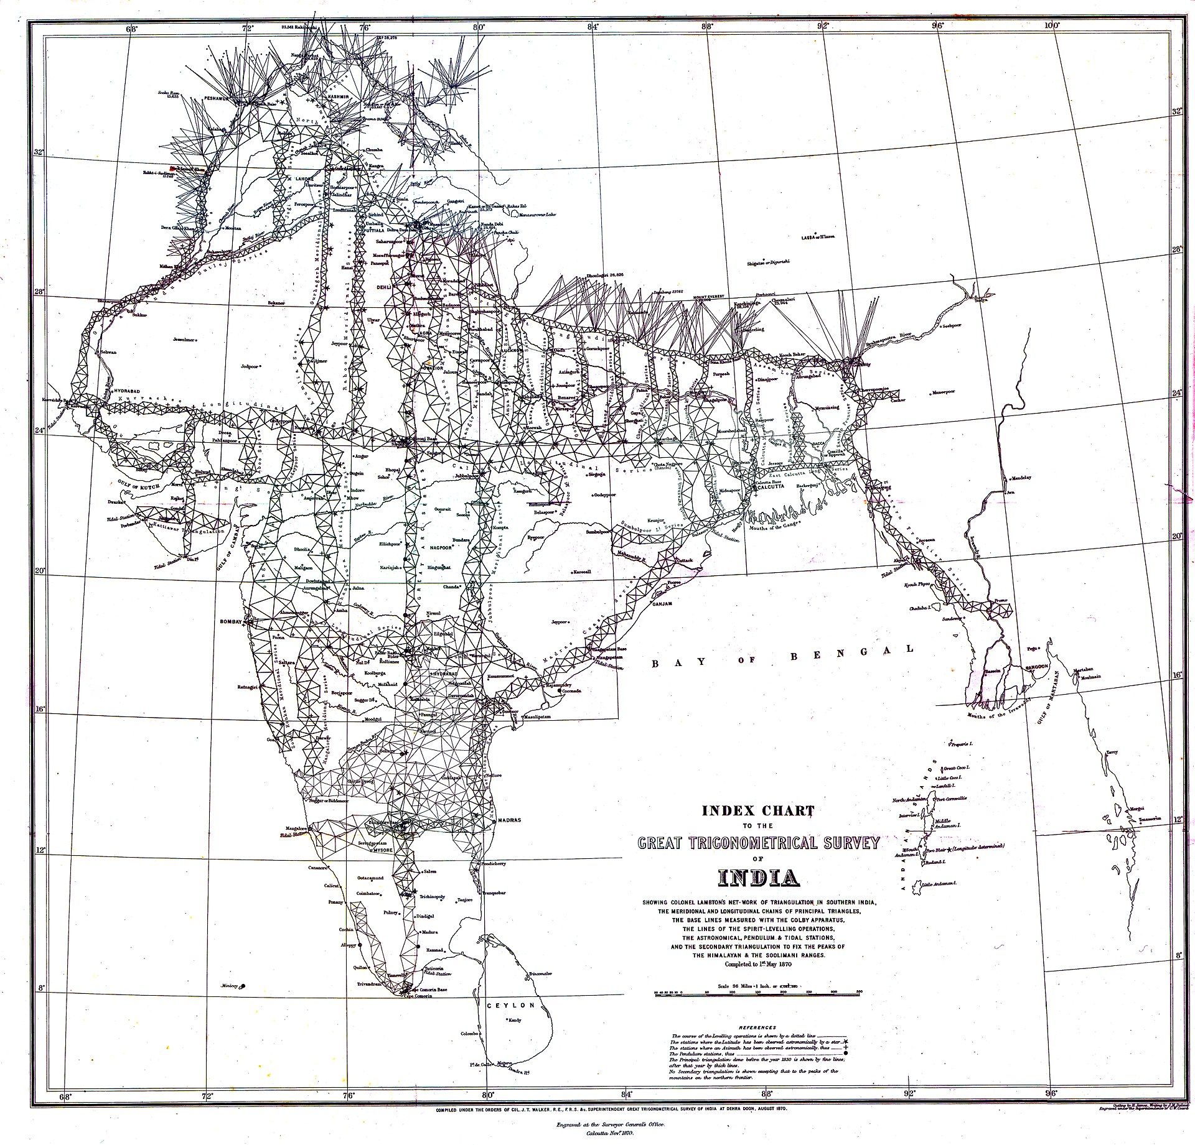
Isostasy
1870 Index Chart of the Great Trigonometric Survey of India
A key ingredient to the acceptance of Plate Tectonics Theory
The motivation that drove the proposed isostasy theory was to answer other questions… relating to the surveying of India

Slide 3
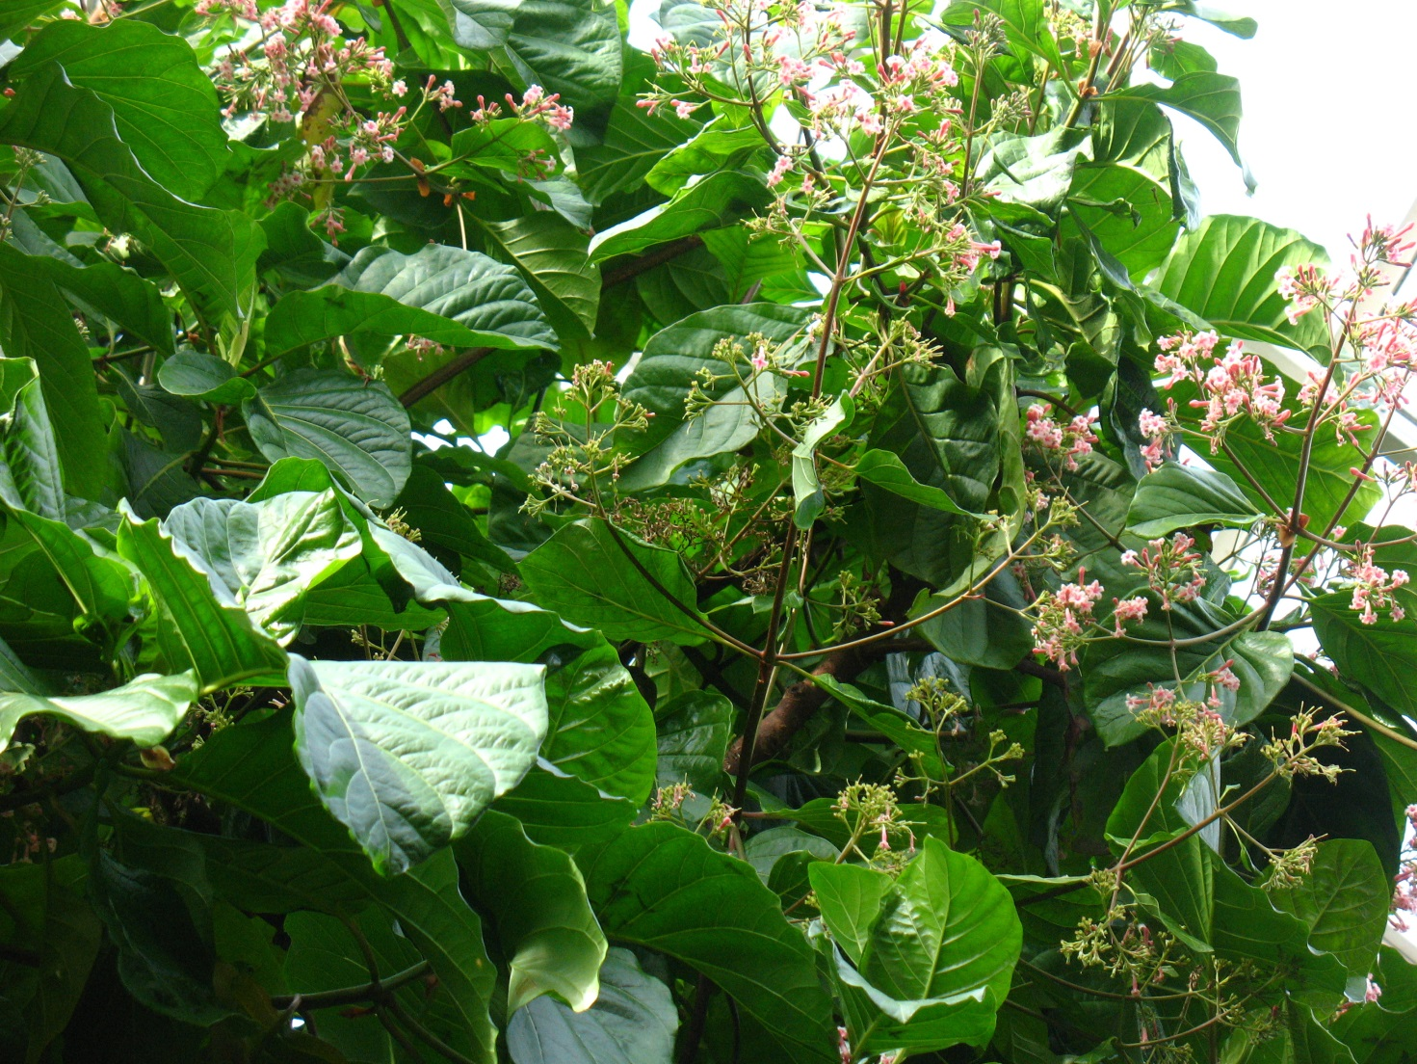
Importance of Surveying India
The Great Trigonometric Survey was a project funded by the East Indian Company whose goal was to accurately geodetically measure British colonial holdings (beginning in 1802, planned to last 5 years but took 70!).
Cinchona genus
Notes:
https://herbologymanchester.wordpress.com/2015/05/27/cinchona-and-treating-malaria/

Slide 4
Importance of Surveying India
Many reasons for doing this, for example:
Clements Markham (Royal Geographic Society) explored Peru and India and suggested Cinchona, native to Peru could be cultivated in India for anti-malarial purposes.
Planting opium in Bengal to overcome trade imbalances between the British and China – luxury Chinese export items like silk and tea were highly sought by the British. Note, two “Opium Wars” followed.
Cinchona genus
Notes:
https://herbologymanchester.wordpress.com/2015/05/27/cinchona-and-treating-malaria/

Slide 5
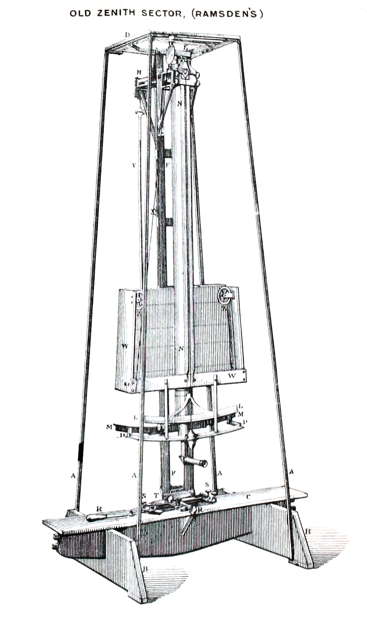
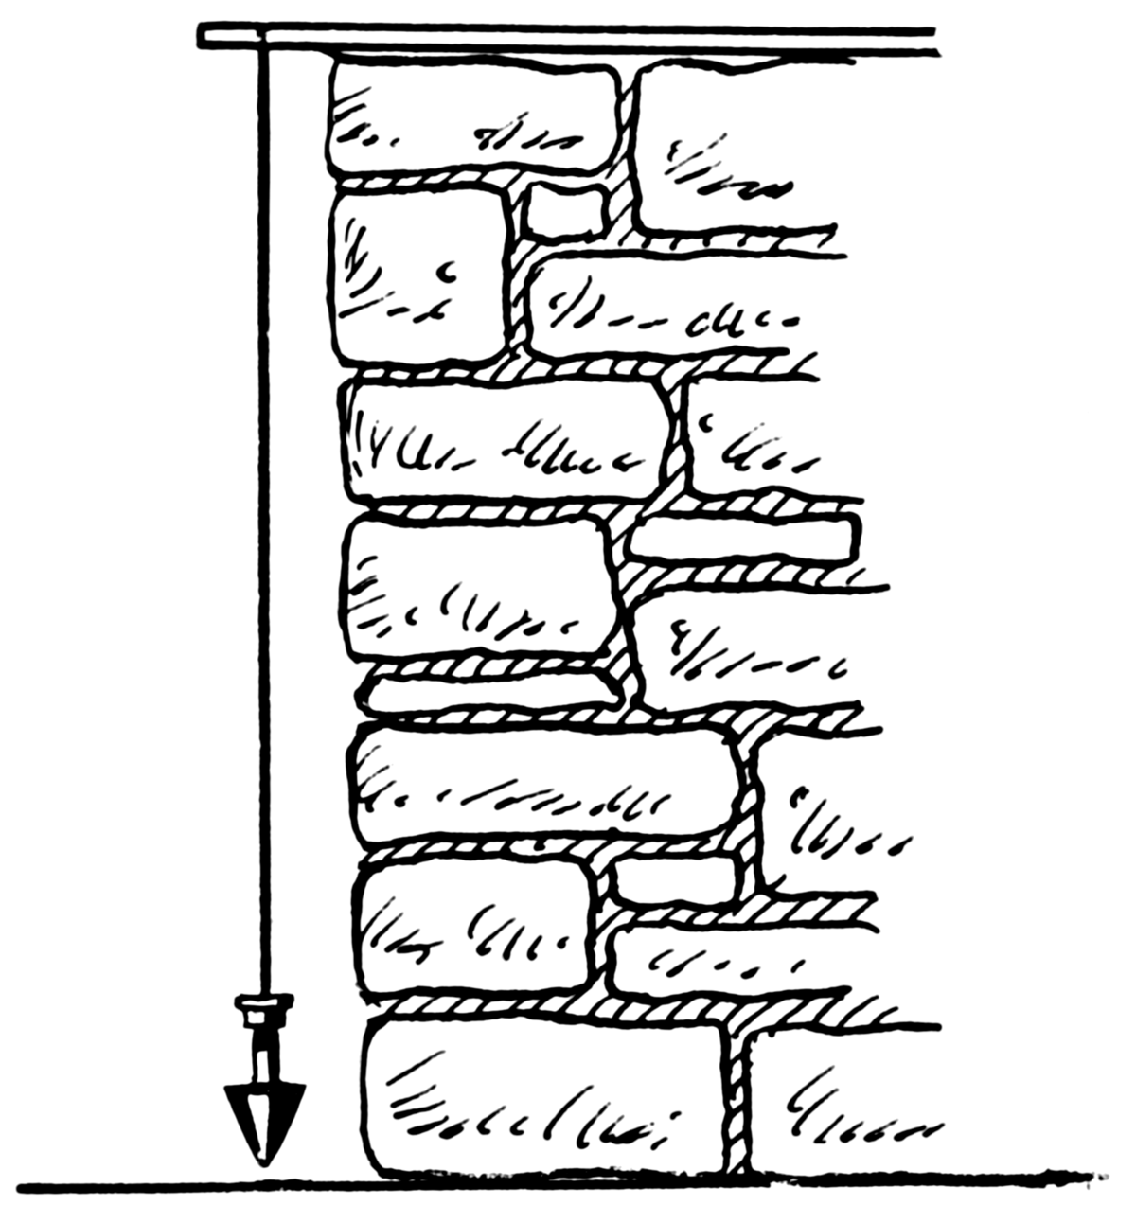
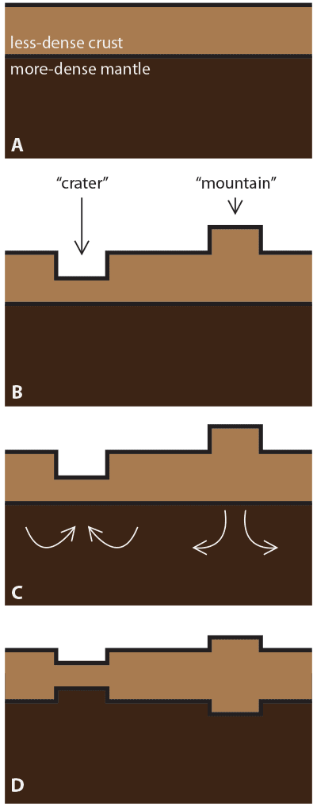
The puzzle
George Everest (surveyor general of India):
Between Kaliana and Kalianpur has a latitude difference of 5 seconds depending if you used astronomical instruments instead of plumblines.
Pratt and later Airy explored how this could be.
Plumbline uses gravity to triangulate
Zenith Sector: telescope pointed towards a known star to get latitude.
assumption
gravity
Airy Isostasy!
Expected when continental plates collide

Slide 6
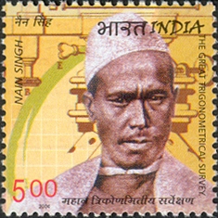
The assist…
For this, much exploration required pandits - local explorers who knew the land and had access to many places Europeans didn’t.
Notable pandits:
Krishna Singh Rawat (awarded Rai Bahadur), Nain Singh Rawat (honored on Indian stamp)
From Markham’s (1878) memoirs:
“Thence they continued their journey in hammocks slung on bamboos, each carried by six men who kept on uttering unearthly discordant yells during the whole of the way to the village of Wundoor, …”
“Thus, it will be seen that his sympathies, whether in India or South America, were invariably directed towards the amelioration of the conditions of life of the natives. Their interests and their happiness were ever uppermost in his thoughts.”
Nain Singh Rawat (2004 stamp)

